Slide 1
PET Speaking Exam

Slide 2
There are 4 parts in the PET Speaking Exam.
Questions
Conversation
Describe a photo
Questions about the topic in part 3
http://www.cambridgeenglish.org/exams/preliminary/exam-format/

Slide 3
In the first part of the speaking exam, you are asked questions about you and your life.
The topics include:
Your hometown
Family & Home
Work & Study
Leisure
Your future
PET PART 1 SPEAKING - QUESTIONS

Slide 4
In Part 2 of the Speaking exam you have to speak to your partner. You are given a situation to discuss.
Remember, it is like a game of tennis, you say what you think and why, then ask what the other person thinks, so you’re passing the conversation from one person to the other.
Make one comment each on each picture (unless you have a comment to make on what your partner has said) and move on, you must talk about each one THEN come to a conclusion, try to avoid saying which is the best/most important/most useful until the end.
Don’t talk too much before passing to your partner, as this will affect your mark.
If you see your partner is finding it difficult, try to help them with some questions, this is good for you and them.

Slide 5
USEFUL PHRASES FOR PART TWO
I agree with you, because …
Yes, you’re right, because …
That’s true, because …
I’m afraid I don’t agree with you, because …
I see what you mean, but …
That’s a good point, but on the other hand …
Okay, let’s make a decision.
Shall we come to a conclusion?
Shall we agree to disagree?

Slide 6
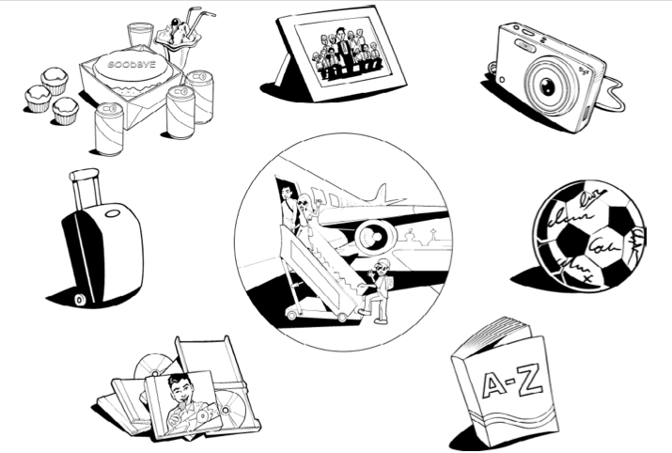
A boy is leaving his school because his parents are going to work in another country. The students in his class want to give him a present. Talk together about the different
presents they could give him and then decide which would be best.
Here is a picture with some ideas to help you.

Slide 7
A boy is leaving his school because his parents are going to work in another country. The students in his class want to give him a present. Talk together about the different
presents they could give him and then decide which would be best.
Here is a picture with some ideas to help you.
Talk together about the different presents they could give him.
Which would be best

Slide 8
In Part 3 of the exam you speak on your own for 1 minute, you are given a photo and have to describe it.
Think about:
Who (Who can you see in the picture?)
What (What is/are the person/people doing, What is the weather like? What is/are they wearing?)
Where (Where is/are the people/place? Where are they? inside or outside)?
When (Is it daytime or nighttime?)
Why (Why might the people be there?)
How (How are the people feeling?)

Slide 9
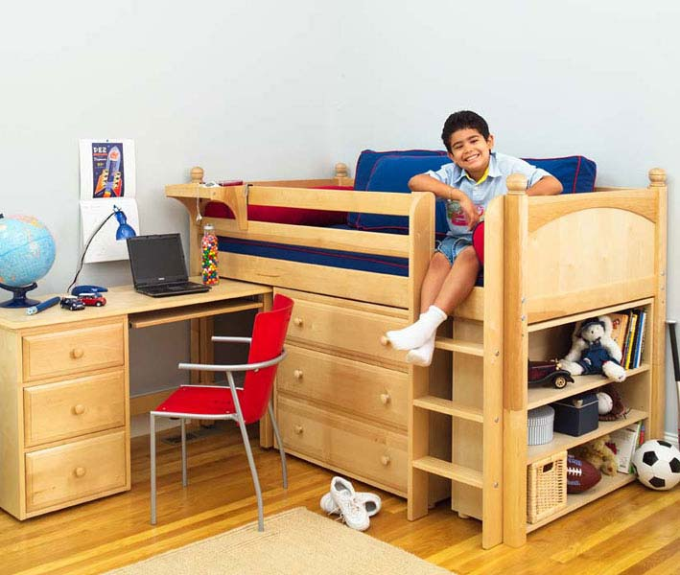

Slide 10


Slide 11
In Part 4 you are asked questions related to the subject of Part 3, so, in this case it might be about your bedroom. In this part you talk to your partner, like you did in Part 2, therefore, remember to ask them questions.
Describe your bedroom.
Do you like to spend time in your bedroom?
What do you like about your bedroom?
What would your perfect bedroom have in it?

